Slide 1
Details of OQC pickup sample & chop stamp
1
Details current procedure from PCS → FA → OQC → SCM
OQC pick up & Return sample
PCS issue Pro plan
Production plan
Pick up sample
Reading barcode Inner/Outer 1st
Weight check 1st
OQC Normal inspection
Reading barcode Product / Inner
Weight check 2nd
Reading barcode Inner/Outer 2nd
Return to Pallet
①
②
③
④
⑤
⑦
⑧
⑨
⑩
SCM shortage
FA confirm stock
Reliability
inspection
⑥
OQC chop stamp
Daily Report
Chop stamp physical all lots
Find all lots same model, shift, Line
Record Pallet ID & S/N carton
Matching Pallet ID & Outer carton box
Find Pallet ID&F/G
⑯
⑮
⑭
⑬
⑫
⑪
FA/SCM
Jupiter
FA
warehouse
FA create
ID pallet
Scan ID pallet to receive by PDA
Confirm receiving by WMS
(21)
⑰
⑱
⑲
⑳
Shipment
(22)
Current situation:
Pickup & Return sample → Manual Job at process: ① ~ ⑦
Chop stamp: Loss time to find pallet → Manual Job at process: ⑪ ~ ⑯
Need to improve

Slide 2


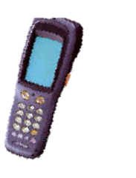







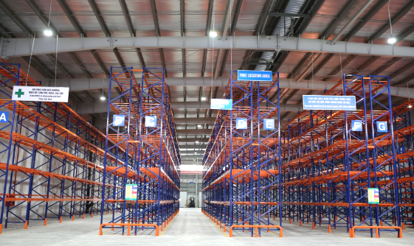
OQC Visualize System
1
4
Flow chart from OQC → FA → SCM → Jupiter
Note:
Pallets that OQC not pickup sample → Can be transferred to SCM warehouse but are still in checking status on OQC system
SCM need to control product under “Checking status” for ensure not ship out to Market
These pallets can be transferred to Jupiter & Jupiter must be linked to OQC system to know whether product status is OK or not
OQC return sample
FA
fix location
E-map
SCM
out location
SCM Warehouse
Ship to
market
OQC System
Jupiter warehouse

